Slide 1
[ logo ]
sign up.
[ logo ]
[ logo ]
welcome!
welcome back!
cairn email
username
create password
login
password
create new account
verify password
keep me signed in
forgot password?
login
already a member? login
sign up

Slide 2
[ logo ]
sign up.
cairn email
create password
verify password
[ logo ]
[ logo ]
[ logo ]
welcome!
what’s your name?
what’s your gender?
already a member? login
sign up
tell us a bit about yourself...
male
female
next
next

Slide 3
[ logo ]
welcome back!
username
password
[ logo ]
keep me signed in
start a match.
[ logo ]
forgot password?
login
finding a match....
random
custom
group

Slide 4
[ logo ]
start a match.
random
i’d like to have lunch with...
i’d like to have lunch with...
custom
grade level:
gender:
[ logo ]
group
customize
freshman
male
sophomore
female
i’d like to have lunch with...
junior
senior or higher
next
next

Slide 5
meet your mealbuddy,
laina.
you have decided to decline.
[ logo ]
view profile
start a match.
decline
accept
could you let us know why?
random
change of schedule
custom
already matched
prefer not to say
group
next

Slide 6
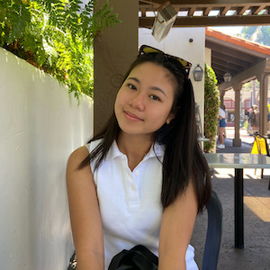
meet your mealbuddy,
laina.
x
hooray!
[ logo ]
laina n.
press exit once you’ve met your mealbuddy.
finding a match....
hi! my name is laina, i am a computer science major. some of my interests include hiking, the office, and sushi.
exit
view profile
decline
accept

